Slide 1
Digital Transformation in
Teaching & Learning

Slide 2
FACILITATOR/ LEAD ENGINEER :
DR JURGEN DALE ( PhD)
NEURAL TECHNOLOGY, MACHINE LEARNING
& ROBOTIC PROCESS AUTOMATION
MASTERS IN BUSINESS ADMINISTRATION
BACHELOR IN DESIGN & ENGINEERING
DIP IN AVIATION
BACHELOR IN AERONAUTICS ENGINEERING
A+N+ Security , MCSE.CCNA. CCNE

Slide 3
INTRODUCING EDULITE
EDULITE WAS DESIGN AND DEVELOPED TO SOLVE SCHOOL ADMININSTRATION, LEARNIG MANAGEMENT AND CENTRAL EDUCATION MANAGEMENT ALLOWING FOR EFFICIENCY, COST REDUCTION AND IMPROVED PRODUCTIVITY ( OURCOME IN TEACHING & LEARNING)

Slide 4
WHY ?
WHERE ?
WHO ?
HOW ?

Slide 5
DUE TO INCREASE IN POPULATION ; SHORTAGE OF TEACHERS, SHORTAGE OF CLASSROOMS, SHORTAGE OF TEACHNING RESOURCES, BUDGET LIMITATION , REMOTENESS & GEOGRAPHY ARE MAJOR ISSUES THAT BECOMES A PROBLEM IN DELIVERY OF QUALITY EDUCATION IN PAPUA NEW GUINEA.
USING THE TECHNOLOGY IS THE FASTEST AND EFFECTIVE WAY OF IMPROVING REAL TIME LEARNING FOR REAL WORLD SCENARIO.
STUDENTS, EMPLOYEES, INDIVIDUALS & OTHERS WILL BENEFIT BY USING EDUTECH TO WIDER AUDIENCE TACKLING MULTI SOLUTIONS IN ONE TIME.

Slide 6
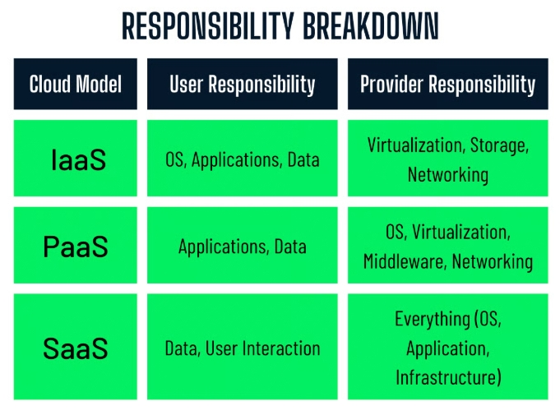

Slide 7
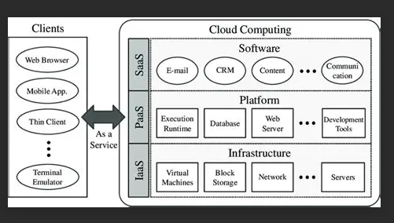

Slide 8


Slide 9
LETS EXPLORE EDULITE TOGETHER
WEBSITE
WEB APPLICATIONS
https://notebooklm.google.com/notebook/932005f9-d230-4a07-8e6b-05e14ffbe1b1

Slide 10
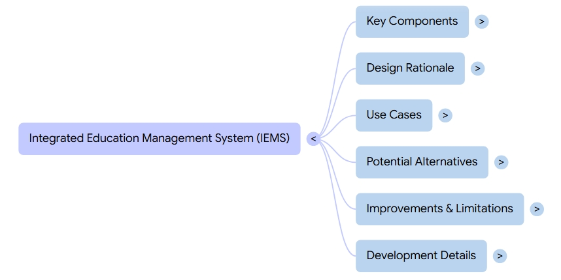

Slide 11
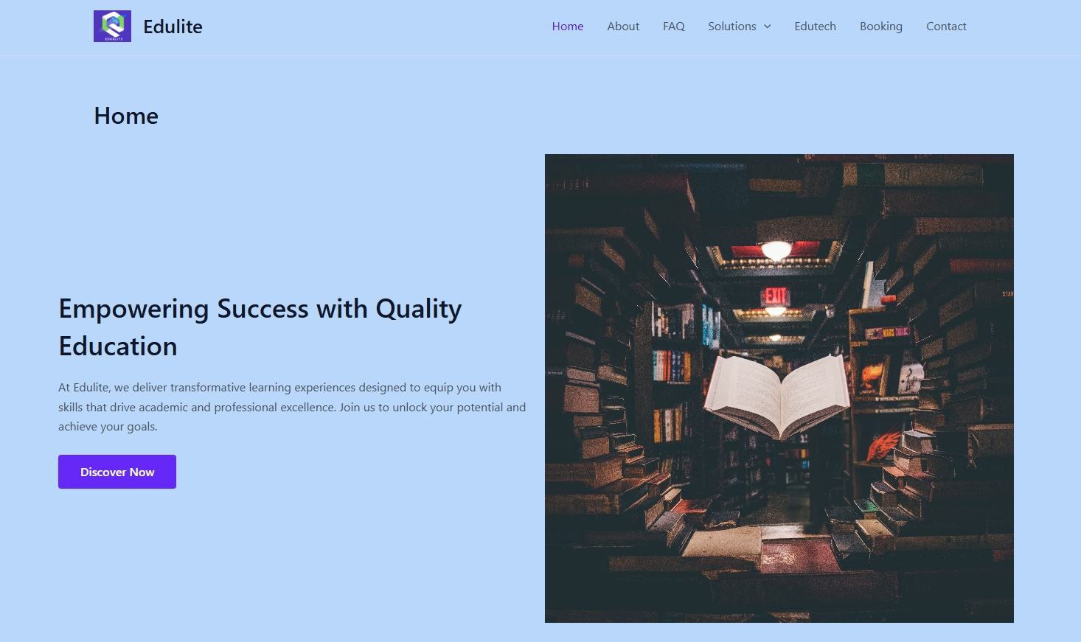
https://edulite.open2study.net

Slide 12
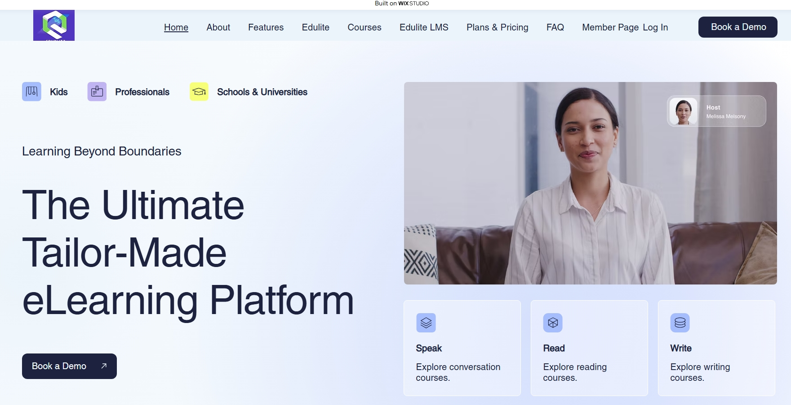

Slide 13
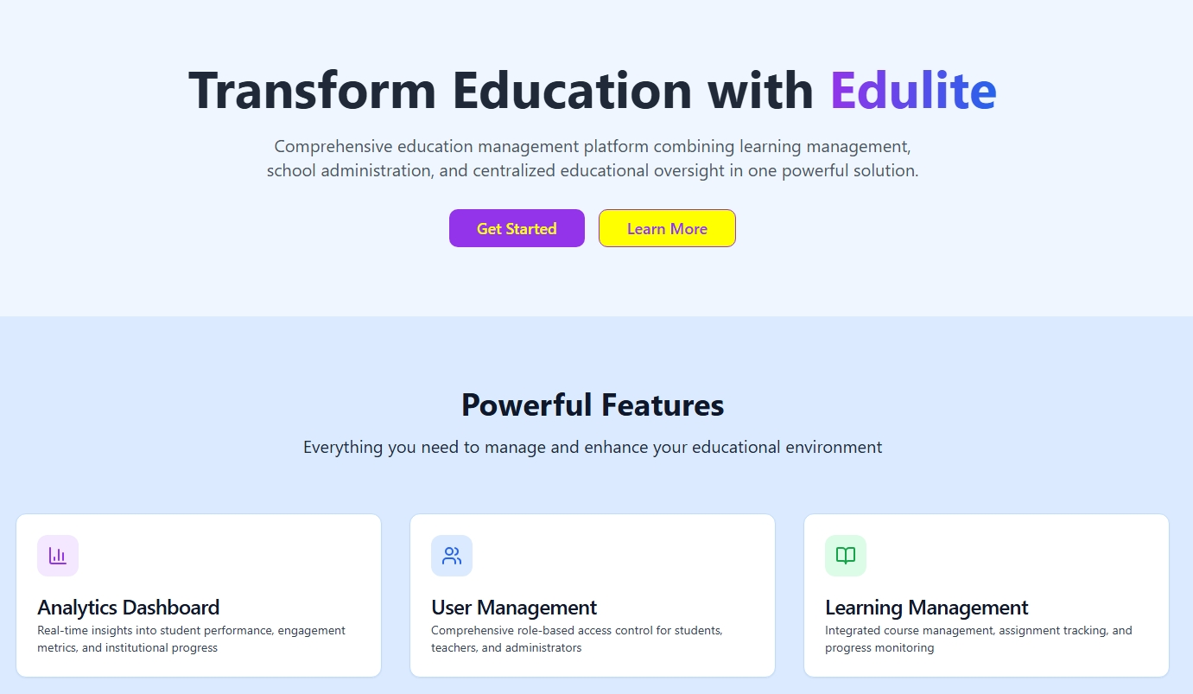
EduVerse

Slide 14
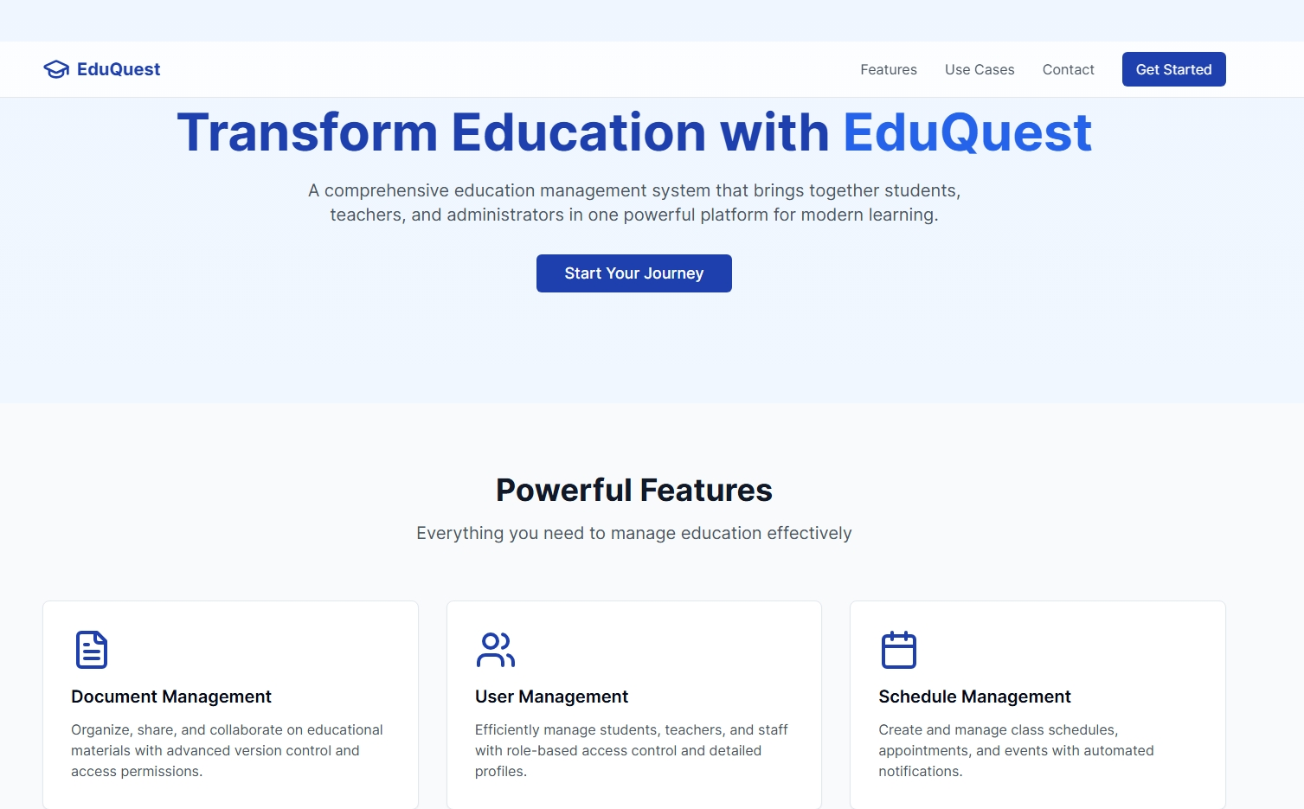
Eduquest

Slide 15
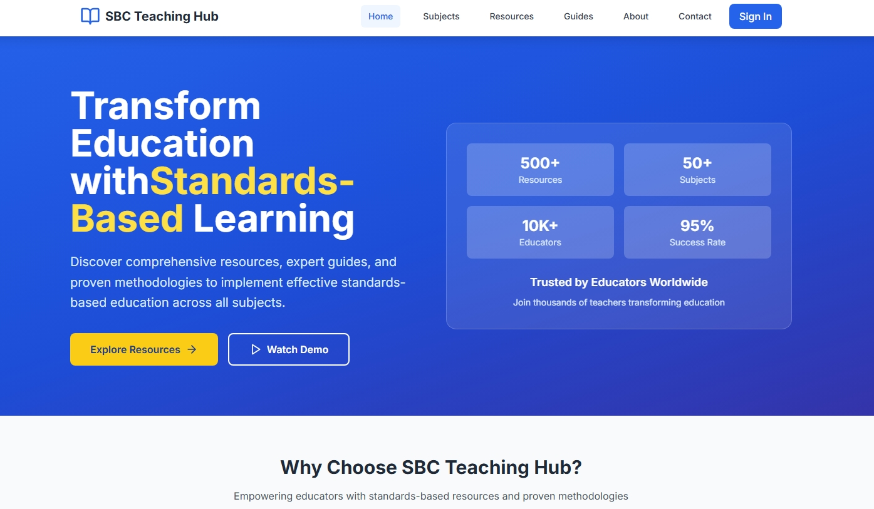
Edulite

Slide 16
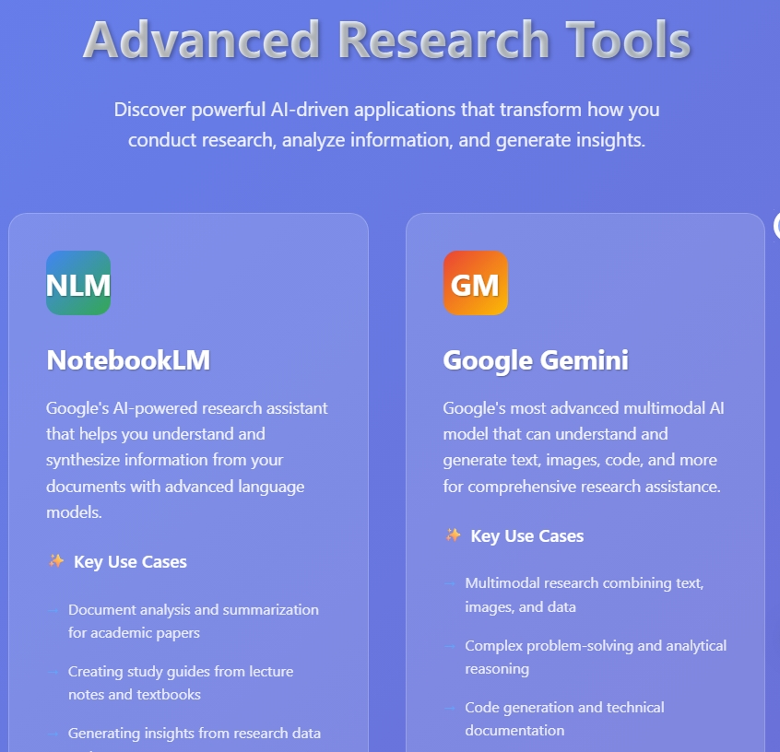
https://claude.ai/public/artifacts/370d4a0f-043e-4461-be68-7496a2d8437c

Slide 17
ANY QUESTIONS?
IF YOU WISH TO TRY IT OUT REQUEST ACCESS THROUGH EMAIL
edulite.info@proton.me

Slide 18
THE END

